Slide 1
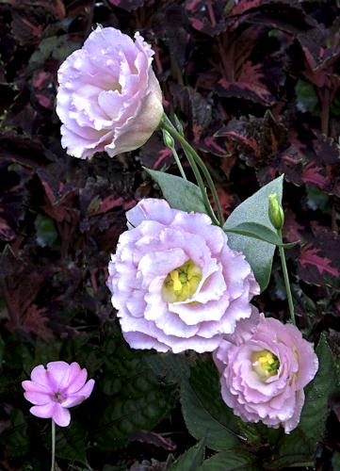
Little Nudges from our Inward Teacher about Beauty

Slide 2
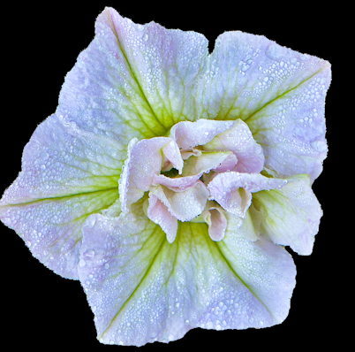
Beauty is a free spirit.
[ John O’Donohue ]

Slide 3
The media generate relentless images of mediocrity and ugliness in talk shows… And so we gain a clear view of how much ugliness we endure and allow…
[ O’Donohue ]

Slide 4
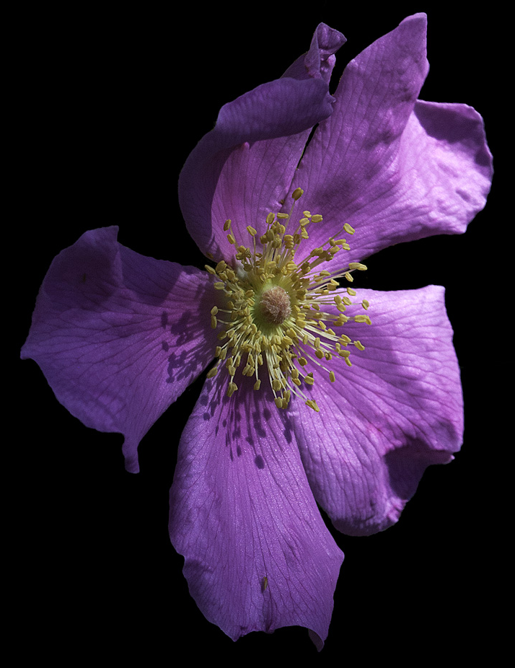
But Beauty is a free spirit. [ O’Donohue ]

Slide 5
The media are becoming the global mirror and these shows tend to enshrine the ugly as the normal standard.
[ O’Donohue ]

Slide 6
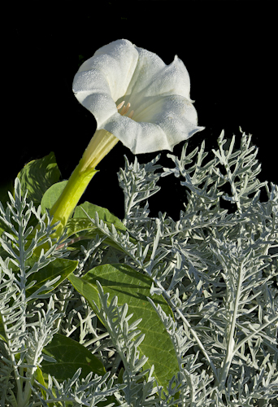
But Beauty is a free spirit.
[ O’Donohue ]

Slide 7
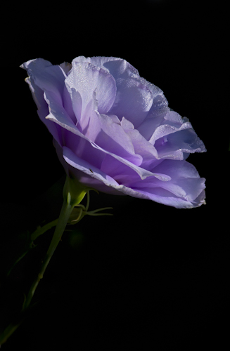
Beauty is mostly forgotten
and made to seem
naïve and romantic.
[ O’Donohue ]

Slide 8
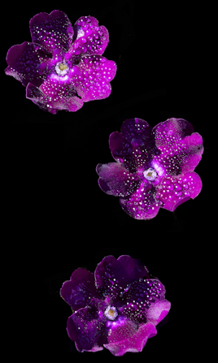
But Beauty is a free spirit.
She enables us to go with,
rather than against
the deepest tendencies
of the Cosmos.
[ O’Donohue ]

Slide 9
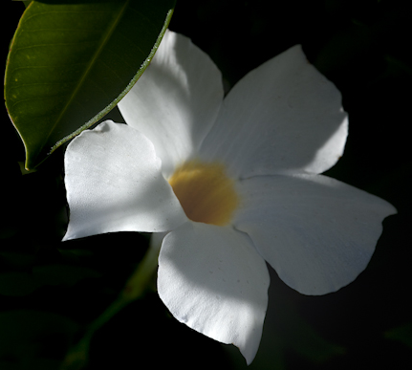
The wonder of Beauty
is her ability to surprise us. [ O’Donohue ]

Slide 10
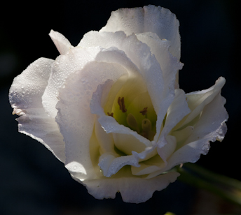
With swift, sheer grace
Beauty is like a divine breath
that blows the heart open.
[ O’Donohue ]

Slide 11
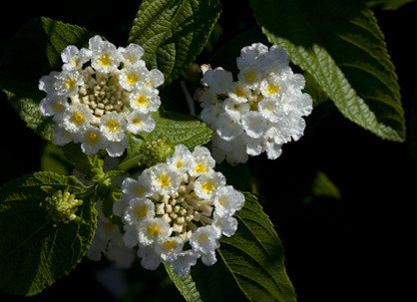
The liveliness of Beauty is
so fulfilling,
we simply enjoy it. [ O’Donohue ]

Slide 12
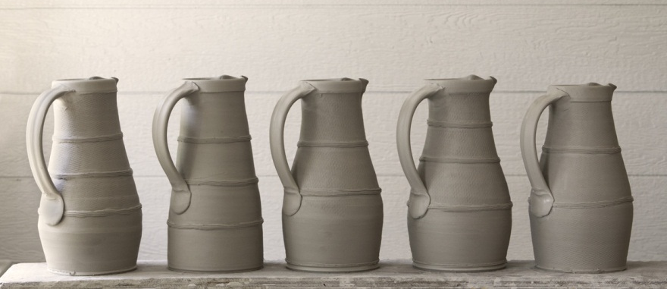
It never occurs to us
to ask
what purpose
Beauty serves. [O’Donohue ]

Slide 13
When we affirm another’s beauty,
we affirm something that cannot be owned
or drawn into the grid of small-mindedness
or emotional need.
[ O’Donohue ]

Slide 14
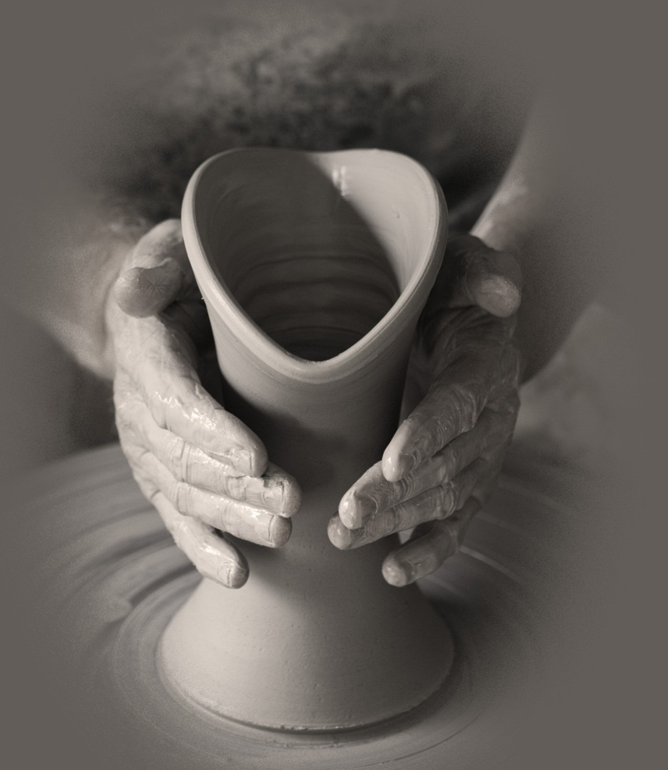
There is a profound nobility
in beauty that can
elevate life.
[ O’Donohue ]

Slide 15
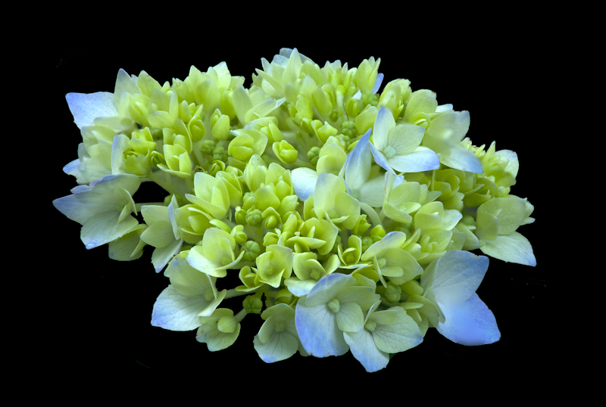
Nature is full
of hidden geometry and harmony,
as is the human mind. [ O’Donohue ]

Slide 16
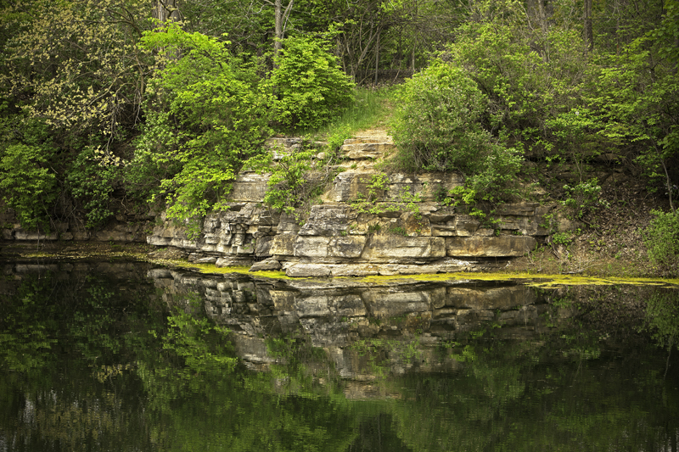
A smile can completely transform a face.
Ultimately, it is the soul
that makes the face beautiful.
Each face is its own landscape. [ O’Donohue ]

Slide 17
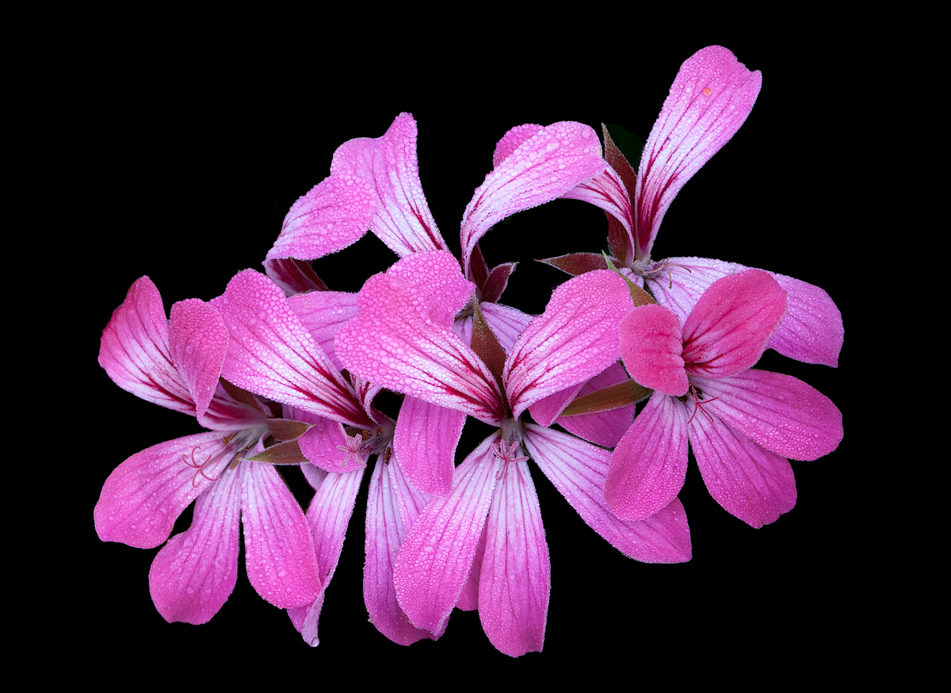
We feel beautiful when we are loved, and
to evoke an awareness of beauty in another
is to give them a precious gift
they will never lose. [ O’Donohue ]

Slide 18
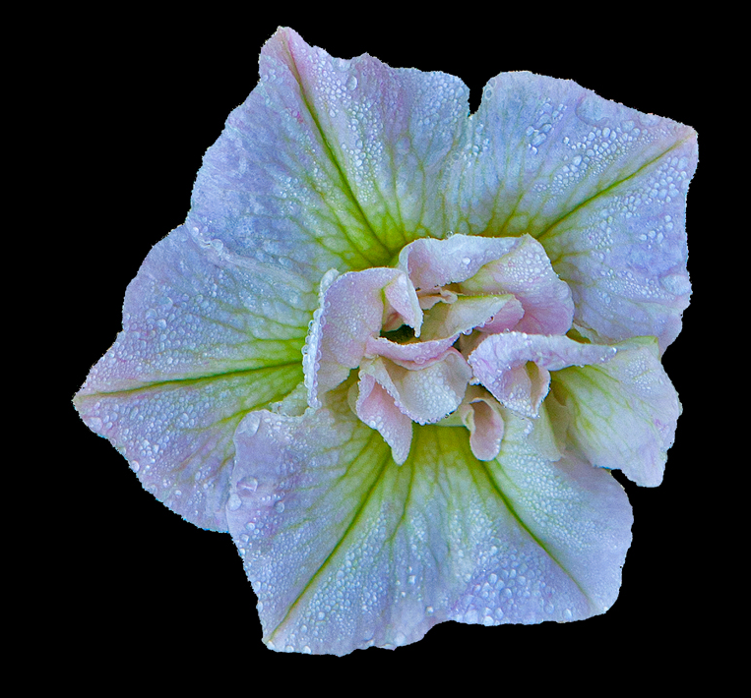
Beauty is a free spirit. [O’Donohue ]

Slide 19
Who are our Companions of Beauty?
our kindred spirits
poets, painters, & stichers,
composers and potters,
musicians and writers,
those who take walks with us to see Beauty,
Who are our close Companions of Beauty who journey with us… ?

Slide 20
What are our Places of Beauty?
where we sense a Presence as no where else?
Places of Stillness, of home,
Where we go for healing,
To find ourselves again…

Slide 21
What are our Doorways into Beauty
we have not entered?
Beauty we have not experienced because
we have not risked going through that door,

Slide 22
Could the obstacles to that door which we created become stepping stones, so now
we take our companions of Beauty with us?
( We ask, would you come with me?)
Beauty is waiting for us on the other side…
Beauty is waiting for our arrival…

Slide 23
Who are our Companions of Beauty?
Our Places of Beauty
The Doorways we have not
walked through, into new Beauty?

Slide 24
In what you have just experienced,
What will you take home with you,
To noodle on, ruminate and chew on,
Maybe take a walk to look for Beauty
Maybe just sit quietly for 5 minutes and absorb a poem, a little music,
the view through your window?

Slide 25
Beauty is a free spirit.
[ O’Donohue ]

Slide 26
Sources:
Photography & editing by John Holliger
Divine Beauty, by John O’Donohue
Music: “Scottish Reflections,” Bonnie Ryder

